Slide 1
Final Presentation
Team (May 15-03)
Shawn LaGrotta | lagrotta@iastate.edu
Matt Eckes | mweckes@iastate.edu
Jacob Mayer | jdmayer@iastate.edu
Trevor Boone | tdboone@iastate.edu
Jacob Schulz | jschulz@iastate.edu
Client
HGST
Advisor
Mr. Harker
Notes:
-No team introduction
-Narrative, flow well
-one or several short embedded videos of demo (>=3minutes)

Slide 2
Agenda
Problem Statement
Background
System Overview
Concept Sketch
Technical Challenges
Motor Issues
Calibration
Requirements
Test Results
Functional Testing
Project Management
Cost
Block Diagram
File Parsing
Use Case
Hypothesis
Summary
Notes:
JD
-(Problem statement)Scope of project (coherent, simple terms – main ideas and intuition
-(System overview)Current design (block diagram, pictures included)
-(Design process)How current design reached and project progress
-(Design process)2-5 technical challenges during design or implementation and brilliant solutions
-(Test Plan)Show existence of coherent test plan
-(Design process and Test Plan)Show we have thought of all possible scenarios, and prepared for impossible scenarios with good testing and debugging plan

Slide 3
Problem statement

Slide 4
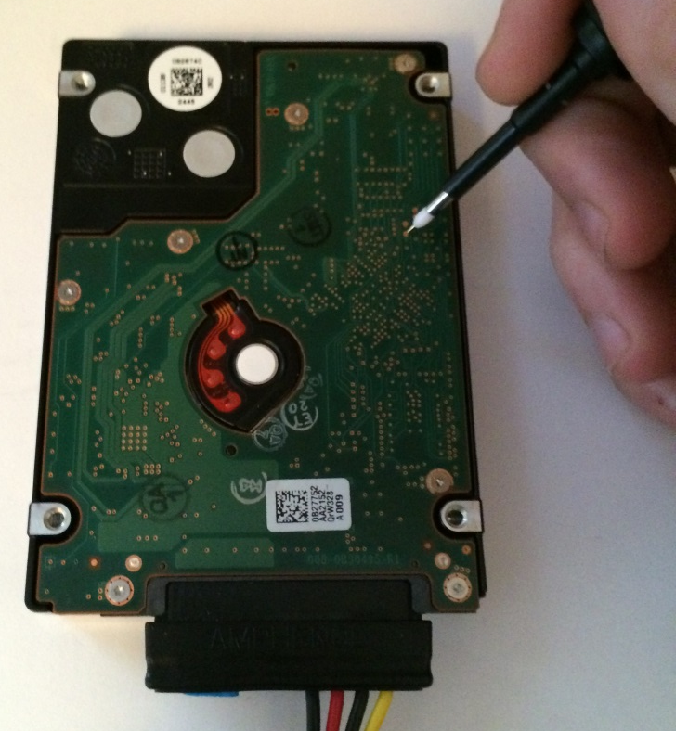
Background
Malfunctioning HDD
Send HDD to engineer
Shipping costs
Find via using chart
Time consuming
High turn around time
Easy to make mistakes
Manually probe via
Notes:
Hard disk drives (HDDs) are complicated systems that require significant amount of investigation and
debugging during development. One important tool used in this work is using oscilloscopes to capture and
examine waveforms that describe the behavior of the device. The waveforms are on specific test points,
which are vias on the HDD PCBA. A typical HDD can have hundreds of these vias.
The goal of this project is to create a robotic oscilloscope probe positioning system to make examining
these signals 1: easier, and 2: possible from a remote location. This will be accomplished by creating a
robotic system capable of positioning an oscilloscope probe onto any of the vias on the drive.
The robotic system must be capable of positioning an oscilloscope probe anywhere on the 2.5" form factor
drive and contacting a via on the PCBA. The system must be able to provide enough pressure on the probe
to create a good electrical connection without damaging the HDD under test or the oscilloscope probe.
JD

Slide 5
Use Case

Slide 6
Requirements
Functional
Hold and move LeCroy Probe
Make a good electrical contact
Non-Functional
Move to any point within 60 seconds
LEDs and LCD that indicate state
Calibration method that ensures accurate performance
Take up less than 4ft³
Support a manual operation mode
Notes:
FUNCTIONAL REQUIREMENTS
• There shall be a probe positioning device and a control system to control it.
• The probe positioning device shall:
o Consistently hold a 2.5” form factor HDD in the same position
o Hold, move, and manipulate the LeCroy Oscilloscope Probes
o Place the probes on HDD PCBA test points with enough force to make a good electrical contact,
yet not enough to damage the PCBA
o Take commands from the control system and act accordingly
o Have a calibration method that ensures accurate placement of the probes on the PCBA
o Allow probes to be grounded to the test fixture and HDD
o Support positioning of at least one probe
• The control system shall:
o Be remotely accessible over the HGST intranet
o Send commands to the probe positioning device (client)
o Receive commands from the remote operator over the intranet (web server)
o Translate commands from remote operator to change the probe position
4.2 NON-FUNCTIONAL REQUIREMENTS
• The device shall move the probe to any point on the board within 60 seconds
• The device shall have LEDs that show the operational status of the device
• The device shall have an LCD to display the coordinates of the probe and operational status
• The robot will return status information back to the client
• It shall take up a volume less than 4 ft3
• The device shall be easily maintained and built from standard parts when possible
• The device should support a manual operation mode
Matt

Slide 7
System overview

Slide 8
Concept Sketch
Concept Sketch

Slide 9
Block Diagram

Slide 10
Software Overview
Notes:
Shawn

Slide 11
Progress

Slide 13
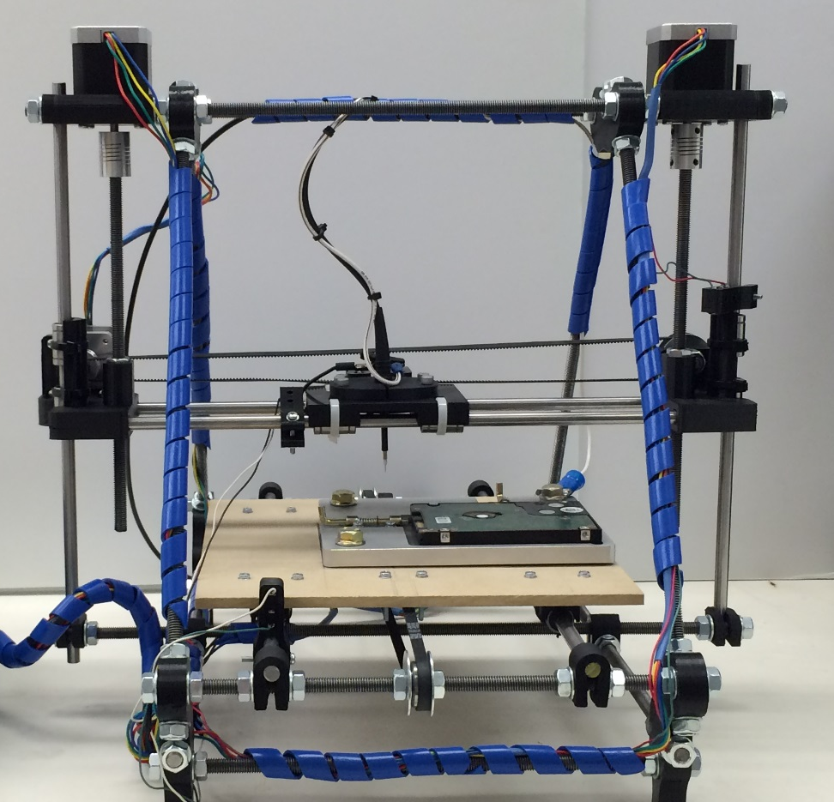

Slide 14
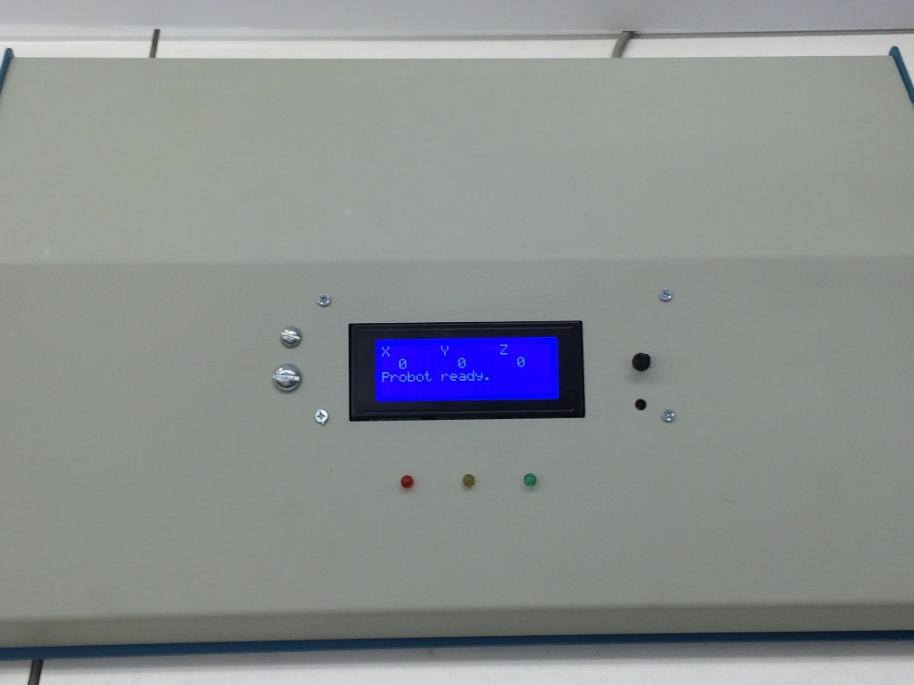
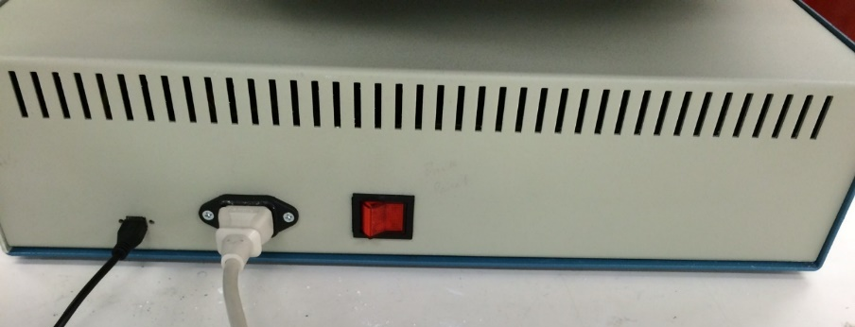

Slide 15
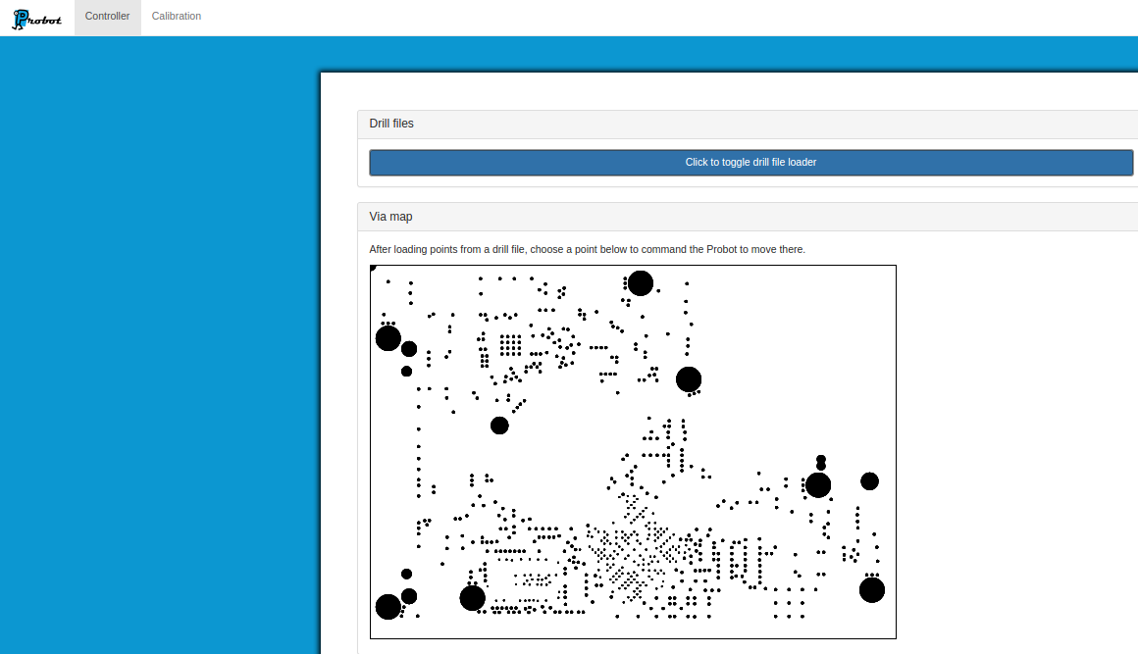

Slide 16
Video

Slide 17
technical challenges

Slide 18
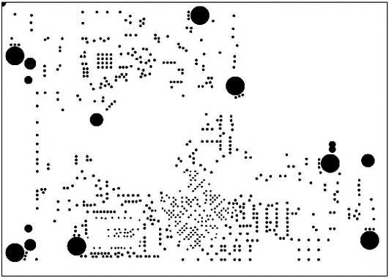
Calibration: Coordinate Translation
Probe/HDD Coordinate System
$${\left[\begin{matrix}x \\ y\end{matrix}\right]}_{new}=\left[\begin{matrix}cos⁡(θ) & −sin⁡(θ) \\ sin⁡(θ) & cos⁡(θ)\end{matrix}\right]{\left[\begin{matrix}x \\ y\end{matrix}\right]}_{old}$$
θ
Notes:
Trevor

Slide 19
Z-Axis Motors
~30 hours to debug
Continuity?
Transients?
Signals?
High Load?
Bad Motor?
Notes:
Jacob
Mention that there is a python library for this (gerbV)
Go down to 2 (Drill, Solder mask)
Although there was continuity in the harness, there was not enough contact to accommodate the appropriate amount of current needed to motor the motor

Slide 20
File Parsing
Binary File
No preparation needed
Information rich
Plain text
Preparation needed
Only contains via coordinates
Proprietary parser
Windows only
Easy to parse
Platform independent

Slide 21
Product Verification

Slide 22
Hardware Testing
Motor Controls
X, Y, and Z Motion
Transition Time
Locating Test Points
Probe Electrical Contact
Notes:
Matt

Slide 23
Hardware Test
Plan
Test 80 randomly generated vias
Results
Time: 21 min 20 seconds (16 seconds between points)
3 Trials
Accuracy: 69/80 vias made electrical contact (86% accuracy)

Slide 24
Test Results Analysis
 | Goal | Actual
Transition time | 60 sec | 16 sec
Accuracy | 80% | 86%

Slide 25
Missed Points
Note: Missed vias by ~5μm
Calibration Point

Slide 26
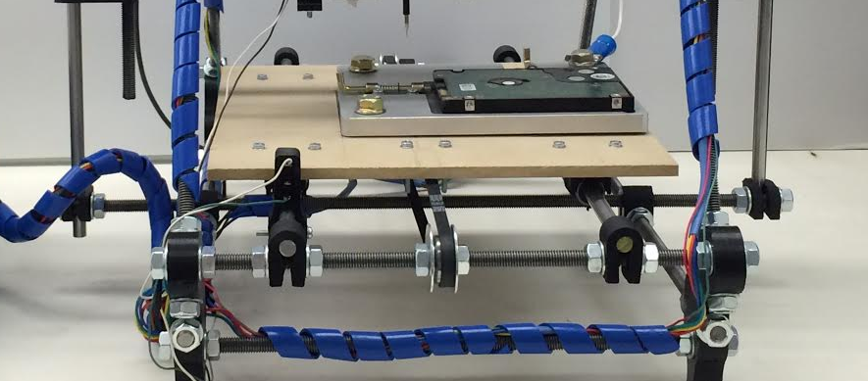
Possible Issue

Slide 27
Cost | Description
$619.37 | RepRap Prusa i2 3D Printer Kit
$50.00 | Raspberry Pi B+ w/ 8GB NOOBS microSD card
$162.14 | Enclosure + Switches + Hardware + Connectors
$32.00 | SainSmart LCD Control Panel
$5.05 | Locked Spring Loaded Metal Security Barrel Bolt Latch 5.5cm
$15.00 | Probe Holder (3D Printed) at $5/in³
$0.00 | HDD Jig
~$883 / $1500 | Total / Budget
Notes:
Jacob
Parts: Raspberry Pi, RepRap, Power Supply for Pi, LCD control panel, HDD latch pins, 3D printed parts.
Total Cost: <$750
Resources: Online ordering, 3D printing place on campus, senior design room

Slide 28
Summary
Problem
Remote HDD Testing
Hardware Solution
Modified 3D Printer
Software Solution
Web + Python + Printer
Cost
~$883 / $1500
Delivery
May 2015
Notes:
Shawn

Slide 29
Questions?

Slide 30
Software Testing
Operational Tests of GUI
Unit Tests
Navigation to Points
File Management
Via Selection Module
File Selector Module
Embedded Communication Module
Notes:
Trevor
See project plan
Tests
File parsing (test files), user interface (visual inspection), remote control (unit tests for each request + return status combo), robot manipulation (visual, test cardinal directions 1000 times each)
Metrics
Accuracy, latency, …?
Hypothesis
…?

Slide 31
Calibration Procedure

Slide 32
HDD

Slide 33
HDD
$$∆x$$
$$θ_{HDD}$$
$$θ_{HDD}=\tan^{−1}\left(\frac{∆y}{∆x}\right)$$
$$∆y$$

Slide 34
Probe

Slide 35
Probe
$$∆x$$
$$θ_{Probe}$$
$$θ_{Probe}=\tan^{−1}\left(\frac{∆y}{∆x}\right)$$
$$∆y$$

Slide 36
Rotation Angle
$θ_{rotation}=θ_{HDD}−θ_{probe}$
${\left[\begin{matrix}x \\ y\end{matrix}\right]}_{new}=\left[\begin{matrix}cos⁡(θ) & −sin⁡(θ) \\ sin⁡(θ) & cos⁡(θ)\end{matrix}\right]{\left[\begin{matrix}x \\ y\end{matrix}\right]}_{old}$

Slide 37
2-Probe Math

Slide 38
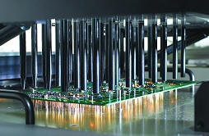
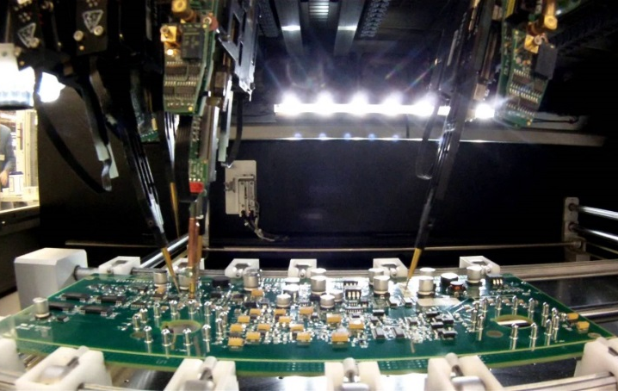
Market Survey
Bed of Nails | Flying Probe
Pros Cons
Notes:
Shawn
Bed of nails
Flat collection of pogo pins: one for each node on circuit board.
This is expensive, but you can test multiple points and switch test points quickly.
Flying Probe
One pogo pin moved to desired node on circuit board.
Less expensive, easier to reconfigure for new circuit boards, but only one test point at a time.
We are using the flying probe method.
Shawn

Slide 39
Schedule – Fall
Notes:
Matt

Slide 40
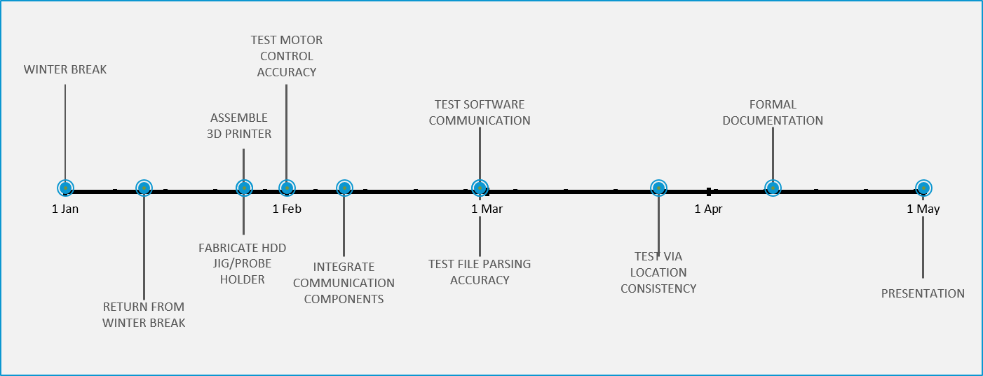
Schedule – Spring
Notes:
Matt

