Slide 1
Design Review
Team (May 15-03)
Shawn LaGrotta | lagrotta@iastate.edu
Matt Eckes | mweckes@iastate.edu
Jacob Mayer | jdmayer@iastate.edu
Trevor Boone | tdboone@iastate.edu
Jacob Schulz | jschulz@iastate.edu
Client
HGST
Advisor
Mr. Harker

Slide 2
Agenda
Problem Statement
Background
System Overview
Concept Explanation
Hardware Design
Existing Technology
Custom Parts
Requirements
Literature Review
Software Design
Server-Client
Robot Control
File Parsing
Project Management
Risks
Cost
Schedule
Concept Sketch
Notes:
JD

Slide 3
Problem statement

Slide 4
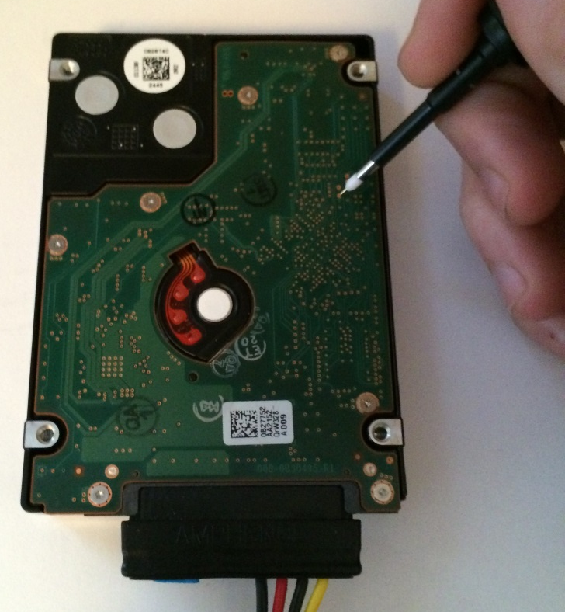
Background
Malfunctioning HDD
Send HDD to engineer
Shipping costs
Find via using chart
Time consuming
High turn around time
Easy to make mistakes
Manually probe via
Notes:
Hard disk drives (HDDs) are complicated systems that require significant amount of investigation and
debugging during development. One important tool used in this work is using oscilloscopes to capture and
examine waveforms that describe the behavior of the device. The waveforms are on specific test points,
which are vias on the HDD PCBA. A typical HDD can have hundreds of these vias.
The goal of this project is to create a robotic oscilloscope probe positioning system to make examining
these signals 1: easier, and 2: possible from a remote location. This will be accomplished by creating a
robotic system capable of positioning an oscilloscope probe onto any of the vias on the drive.
The robotic system must be capable of positioning an oscilloscope probe anywhere on the 2.5" form factor
drive and contacting a via on the PCBA. The system must be able to provide enough pressure on the probe
to create a good electrical connection without damaging the HDD under test or the oscilloscope probe.
JD

Slide 5
Functional Requirements
Objective
Control system for oscilloscope probe
LeCroy Oscilloscope Probe
Contact
Enough pressure to make good electrical contact with PCBA
Control
Execute commands from remote user
Notes:
FUNCTIONAL REQUIREMENTS
• There shall be a probe positioning device and a control system to control it.
• The probe positioning device shall:
o Consistently hold a 2.5” form factor HDD in the same position
o Hold, move, and manipulate the LeCroy Oscilloscope Probes
o Place the probes on HDD PCBA test points with enough force to make a good electrical contact,
yet not enough to damage the PCBA
o Take commands from the control system and act accordingly
o Have a calibration method that ensures accurate placement of the probes on the PCBA
o Allow probes to be grounded to the test fixture and HDD
o Support positioning of at least one probe
• The control system shall:
o Be remotely accessible over the HGST intranet
o Send commands to the probe positioning device (client)
o Receive commands from the remote operator over the intranet (web server)
o Translate commands from remote operator to change the probe position
4.2 NON-FUNCTIONAL REQUIREMENTS
• The device shall move the probe to any point on the board within 60 seconds
• The device shall have LEDs that show the operational status of the device
• The device shall have an LCD to display the coordinates of the probe and operational status
• The robot will return status information back to the client
• It shall take up a volume less than 4 ft3
• The device shall be easily maintained and built from standard parts when possible
• The device should support a manual operation mode
Matt

Slide 6
Non-Functional Requirements
Time
Move to test point within 60 seconds
Indicators
LEDs and LCD display to show operational status
Communication
Provide status feedback to the user
Size
System should be limited to 4 cubic feet
Notes:
Matt

Slide 7
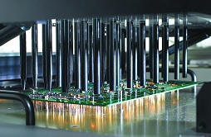
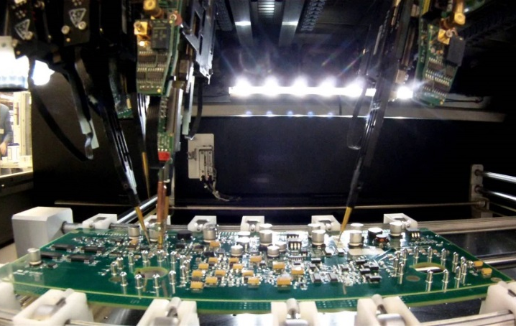
Market Survey
Bed of Nails | Flying Probe
Pros Cons
Notes:
Shawn
Bed of nails
Flat collection of pogo pins: one for each node on circuit board.
This is expensive, but you can test multiple points and switch test points quickly.
Flying Probe
One pogo pin moved to desired node on circuit board.
Less expensive, easier to reconfigure for new circuit boards, but only one test point at a time.
We are using the flying probe method.
Shawn

Slide 8
System overview

Slide 9
Concept Explanation
Hardware
HDD Jig
Software
File Parser
Robot Control
Probe Holder
3D Printer
Client-Server
Notes:
Jacob
Uniqueness
Using an open source 3D printer as coordinate movement platform, and inexpensive Raspberry Pi as web server for user interface.
Industry uses custom made / low volume coordinate platform and interface hardware, which can be expensive.

Slide 10
Concept Sketch
Concept Sketch
Notes:
Trevor

Slide 11
Hardware Design

Slide 12
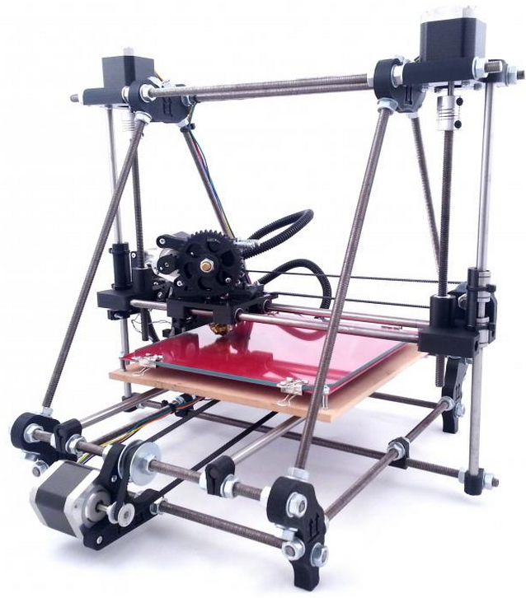
Existing Hardware
RepRap Prusa Mendel I2
Notes:
JD
Prusa i2: 0.1 mm positioning accuracy

Slide 13
Custom Hardware – HDD Jig
Material: Aluminum
Supports 2.5” HDD
Secured using latches
Notes:
JD

Slide 14
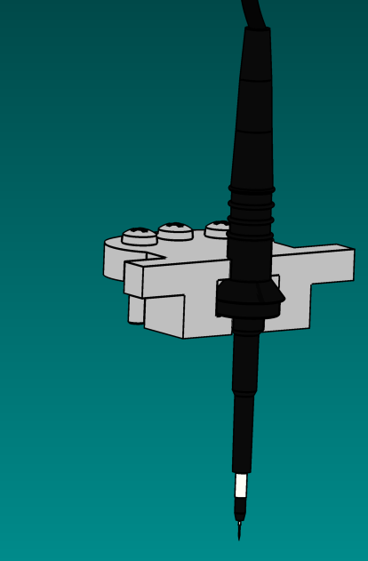
Custom Hardware – Probe Holder
Material: ABS Plastic
Supports LeCroy PP007 Probe
Fastens into 3D printer carriage
Spring loaded tip
Notes:
Matt

Slide 15
Hardware Testing
Motor Controls
X, Y , and Z Motion
Transition Time
Locating Test Points
Probe Electrical Contact
Notes:
Matt

Slide 16
Software Design

Slide 17
Overview
Software is broken up into three main modules: client, server, and robot.
Gerber & Tool File Parser
User Interface & Web Client
Web Server
G-Code Generator
Host Software & G-Code Interpreter
Firmware
Notes:
Shawn

Slide 18
File Parsing
Gerber files
Copper
Drill
Solder Mask
Combine
X,Y
X,Y
X,Y
Parse
Test Points
Parse
Parse
Notes:
Jacob
Mention that there is a python library for this (gerbV)
Go down to 2 (Drill, Solder mask)

Slide 19
Calibration
Manually move probe over left most bottom via to set the origin
Notes:
Trevor

Slide 20
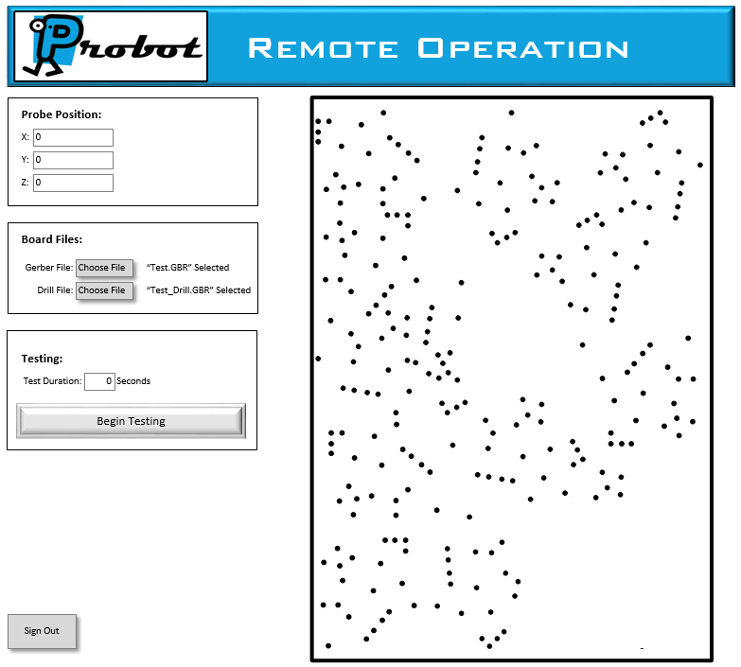
Server-Client
The client software allows for control by the user and communication with the server.
The server is a point of communication for the client for management and delegation of actions to the robot.
Notes:
Shawn

Slide 21
Robot Control
A source (server) inputs G-Code…
…Then the host software & firmware outputs electrical control signals which manipulates the robot.
Host Software
G-Code Interpretation
Command Generation
Firmware
Command Execution
Command Management
Delegation to Firmware
Signal Generation
Status Updates
Notes:
Shawn

Slide 22
Software Testing
Operational Tests of GUI
Unit Tests
Navigation to Points
File Management
Via Selection Module
File Selector Module
Embedded Communication Module
Notes:
Trevor
See project plan
Tests
File parsing (test files), user interface (visual inspection), remote control (unit tests for each request + return status combo), robot manipulation (visual, test cardinal directions 1000 times each)
Metrics
Accuracy, latency, …?
Hypothesis
…?

Slide 23
Project Management

Slide 24
Risks
Operation
HDD
Damage
Calibration Issues
Time
Part Fabrication
Unexpected Challenges
Legal
Licenses
Proprietary File Sharing
Notes:
Jacob
Parts might not come in on time; order early.
Legal team may not get disclosure approved in time; design so custom files not required for use (enter points by hand, maybe).
Calibration

Slide 25
Costs
Cost | Description
$619.37 | RepRap Prusa i2 3D Printer Kit
$40.00 | Raspberry Pi B+ w/ 8GB NOOBS microSD card
$5.99 | AC to DC 5V 2A international to microUSB
$32.00 | SainSmart LCD Control Panel
$5.05 | Locked Spring Loaded Metal Security Barrel Bolt Latch 5.5cm
~$10.00 | Probe Holder (3D Printed) at $5/in³
~$100.00 | HDD Jig
~$863 / $1500 | Total / Budget
Notes:
Jacob
Parts: Raspberry Pi, RepRap, Power Supply for Pi, LCD control panel, HDD latch pins, 3D printed parts.
Total Cost: <$750
Resources: Online ordering, 3D printing place on campus, senior design room

Slide 26
Schedule – Fall
Notes:
Matt

Slide 27
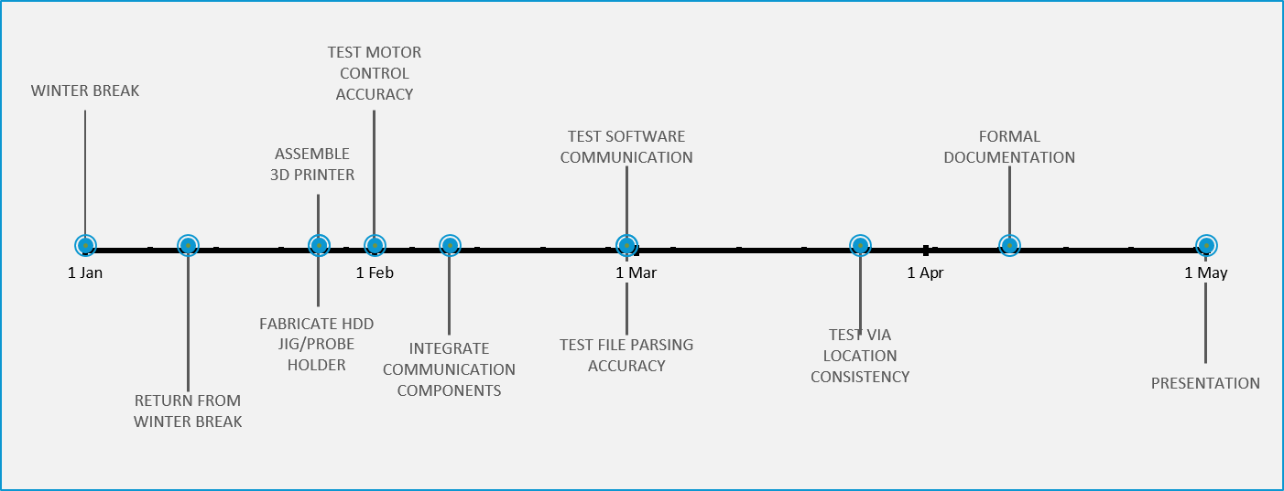
Schedule – Spring
Notes:
Matt

Slide 28
Summary
Problem
Remote HDD Testing
Hardware Solution
Modified 3D Printer
Software Solution
Web + Python + Printer
Cost
~$863 / $1500
Delivery
May 2015
Notes:
Shawn

Slide 29
Questions?

Slide 30
Block Diagram

